Slide 1
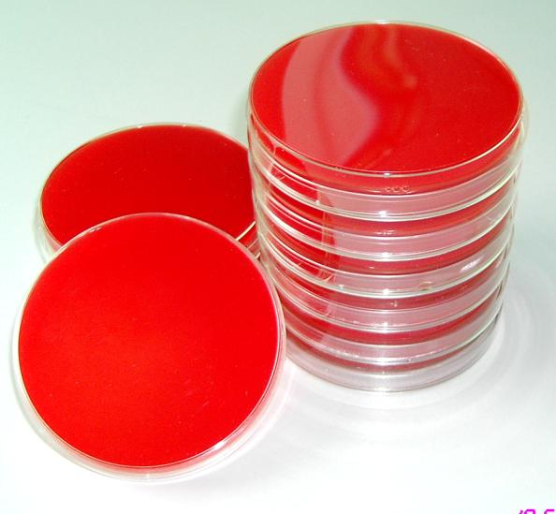
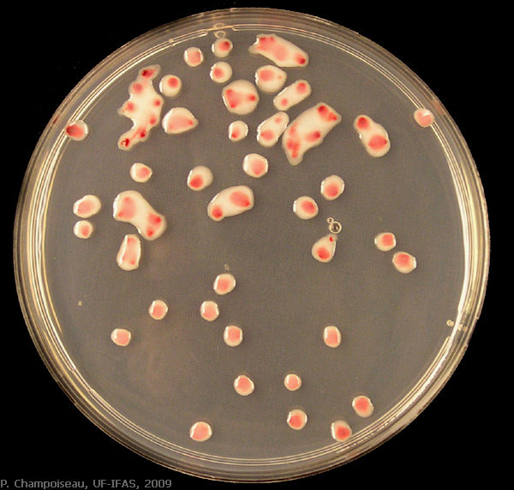
CULTURE MEDIA & CULTURES IN
ENDODONTICS

Slide 2
In search of endodontic pathogens. . . .
Microscopic examination
Culture
Immunological methods
Molecular methods

Slide 3
PRINCIPLES OF CULTURE
To determine the bacteriologic status of root canal system before obturation & assess the efficacy of debridement procedure
To grow & isolate the microbial flora for antibiotic sensitivity & resistance profiles in cases of persistent infections
To determine the effectiveness of inter appointment medication & seal

Slide 4
INDICATIONS
1. antibiotic sensitivity test - assessment of antibiotic sensitivity of resistant / mixed endodontic pathogens in different endodontic cases

Slide 5
2. In medically compromised patients who requires more precise monitoring of microbiologic profile such as –
A- undergoing immunosuppressive therapy ( e.g. organ transplant patients )
B- at high risk for endocarditic (e.g. rheumatic disease)
c. Pts who have to under go heart valve replacement with prosthesis

Slide 6
Culture media are required to grow organisms from infected material to identify the causative agent

Slide 7
TYPES OF CULTURE MEDIA
ACCORDING TO FORM / CONSISTENCY OF MEDIA
Solid media
Liquid media
Semisolid media
ACCORDINT TO CONSTITUENTS OF MEDIA
Simple media
Complex media
Synthetic or defined media
Special media
- Enriched media
- Enrichment media
- Selective media
- Indicator or differential media
- Sugar media
- Transport media

Slide 8
ACCORDING TO TYPE OF BACTERIAL GROWTH THEY SUPPORT
Aerobic media
Anaerobic media
ACCORDING TO FUNCTION & USE
Basal media – nutrient agar
Complex media
1. Enrichment media
2. Selective media
3. Differential media
4. Transport media

Slide 9
CULTURING TECHNIQUE
ADVANTAGES & DISADVANTAGES OF CULTURING TECHNIQUES
ADVANTAGES | DISADVANTAGES
Broad range of identification | Certain species are uncultivable & certain cultivable species are difficult to identify
Culture helps to determine the bacteriological status of the root canal | Time consuming, laborious process
Helps to isolate microbial flora , for antibiotic sensitivity & resistant profiles | Less sensitivity Less specificity

Slide 10
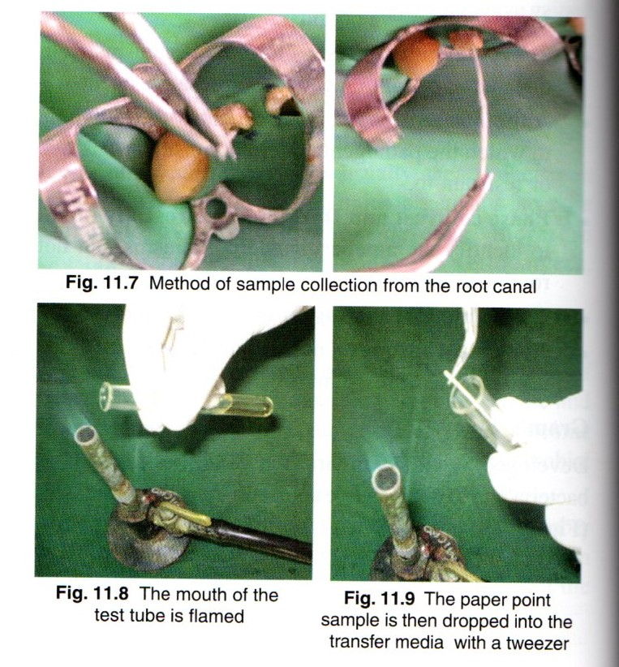
CULTURING FROM ROOT CANAL
ROOT CANAL SAMPLE – IN DRAINING CANALS
Wipe away residual antibiotic /antiseptic from the surface of root canal
Insert absorbent point in the root canal for atleast one minute

Slide 11
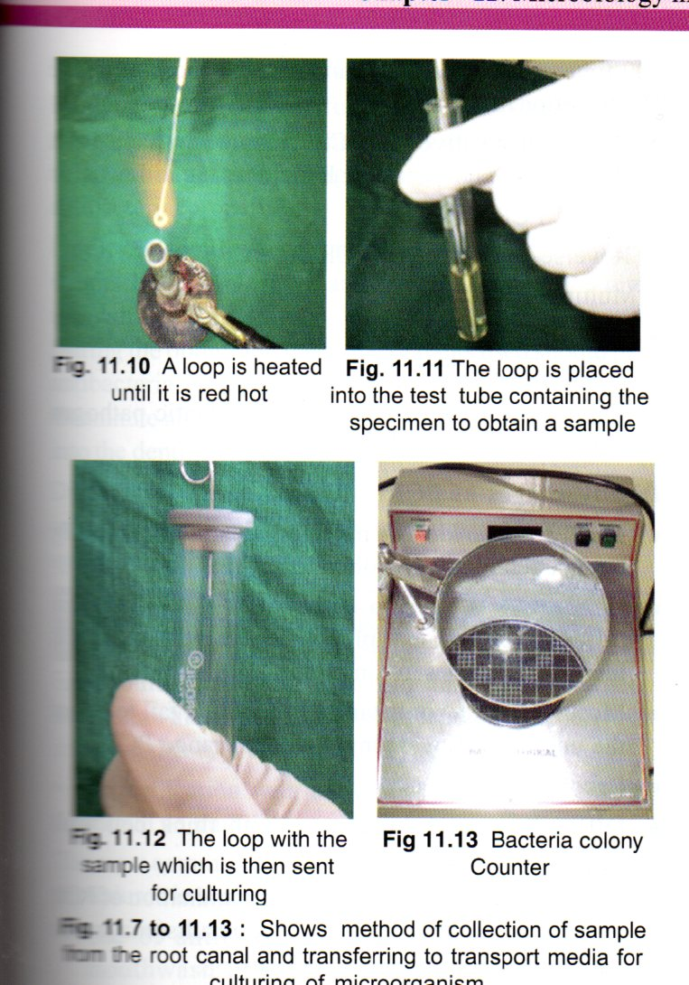
Tip of the absorbent point will be moist when removed from the canal
Flame the lip of the culture tube
Drop the absorbent point into the culture tube & replace the cap

Slide 12
ROOT CANAL SAMPLING – IF DRY CANAL
Inject few drops of pre reduced anaerobicaly sterilized medium into the chamber
Pump the medium into the root canal with sterile endodontic file
Aspirate fluid with leur lock syringe
Eject any air inside the syringe barrel immediately
Transport to anaerobic culture depot within 4 hrs

Slide 13
MUCOSAL SWELLING – CULTURE TECHNIQUE
Insert sterile needle into disinfected mucosal surface
Aspirate the exudate
Insert the needle into an anaport vial & eject the fluid
Transport to anaerobic culture depot within 4 hrs
after obtaining the specimen , perform incision & drainage

Slide 14
CULTURE REVERSAL
Negative culture becomes positive by 24-72 hrs
Advised to allow more than 48 hrs before taking culture & obturation (98 hrs / more )
Culture tube should be re- examined immediately before obturating a canal so that no evidence of growth is present

Slide 15
ANTIBIOTIC SENSITIVITY TEST
Done by agar disk- diffusion method
A filter disk impregnated with a standard amount of an antibiotic is applied to the surface of the plate & the antibiotic is allowed to diffuse into the adjacent medium.
The result is a gradient of antibiotic surrounding the disk.
Following incubation , a bacterial lawn appears on the plate

Slide 16
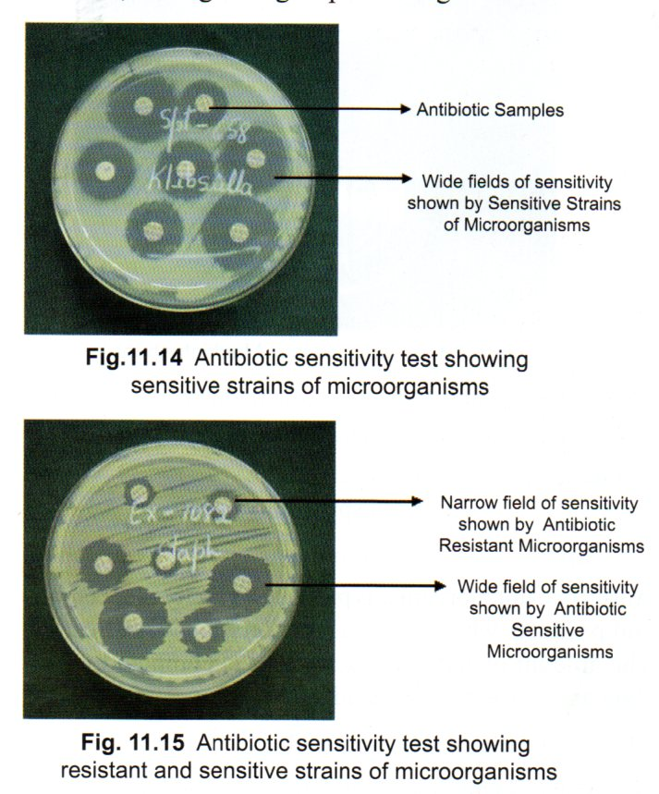
Zones of inhibition of bacterial growth may be present around the antibiotic disk
The size of the zone of inhibition is dependent on the diffusion rate of antibiotic , the degree of sensitivity of the microorganism & the growth rate of the bacterium

Slide 17
If the bacterium is sensitive to a particular antibiotic , it will not grow close to the disk
If the bacterium is resistant to an antibiotic , it will grow right up to edge of disk

Slide 18
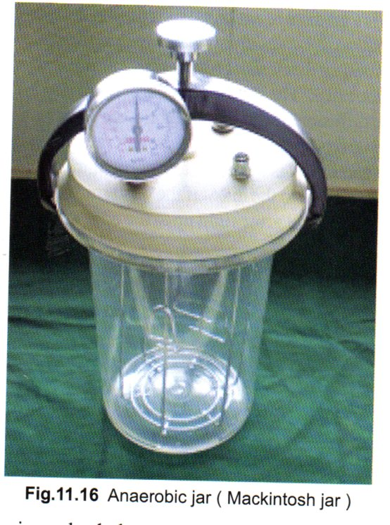
ANAEROBIC CHAMBER TECHNIQUE
Gas impermeable plastic bags are used as chambers
Anaerobiosis is achieved by
flushing with 5% to 10% H2
5% to 10%CO2
80%to 90%N2
In the presence of active palladium catalyst
The gas packs can be used effectively to produce anaerobic environment during culture sampling procedure & transfer of culture to & from transfer media

Slide 19
PHASE CONTRAST & DARK FIELD MICROSCOPY
Allows for the visualization of living unstained microorganisms .
Helps to evaluate the relative number of bacterial morphotypes & bacterial mobility
Outline of the bacteria appears against a light background under phase contrast & black background under dark field microscopy
DISADVANTAGES:
Less specificity
Less sensitive

Slide 20
MOLECULAR DIAGNOSTIC METHOD
Identifies microorganisms using gene as a target that are unique for each species
Polymerase chain reaction (PCR) is a gold standard

Slide 21
POLYMERASE CHAIN REACTION (PCR)
Identify the most resistant strains of microorganisms
Based on the in-vitro replication of DNA through repetitive cycles of denaturation , primer annealing & extensive steps .
It is 10-100 times more sensitive than other sensitive identification methods

Slide 22
PCR TECHNOLOGY
Nested PCR
Reverse transcriptase PCR (RT-PCR)
Multiplex PCR
Real - Time PCR
Broad range - PCR

Slide 23
DISADVANTAGES OF PCR
Identify microorganisms qualitatively but not quantitatively ( obtained by real time PCR )
Detect one species / few different species ( multiplex PCR ) , broad range PCR identify all species in community
Laborious , costly
Difficult in microorganisms with thick cell wall ( fungi )
Chance of false positive ( contamination of PCR )& false negative results (enzymatic inhibition of amplification reaction)

Slide 24
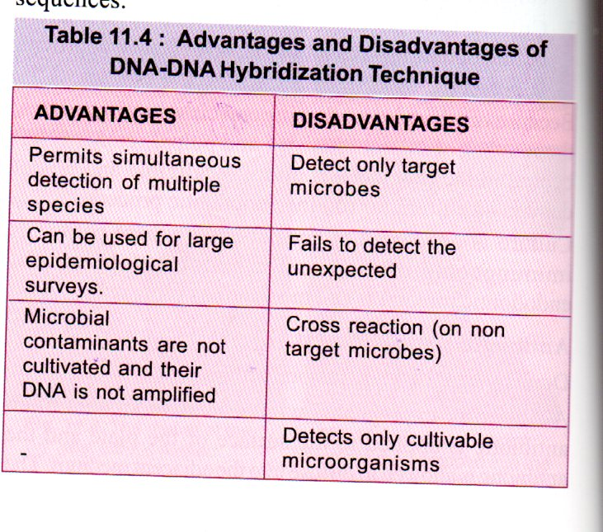
DNA –DNA HYBRIDIZATION
DNA probes labeled with an enzyme , radioactive isotope/ a chemiluminescence reporter that binds to their complementary nucleic acid sequences

